Slide 1
MODFLOW Background
Introduction to Groundwater Modeling using MODFLOW

Slide 2
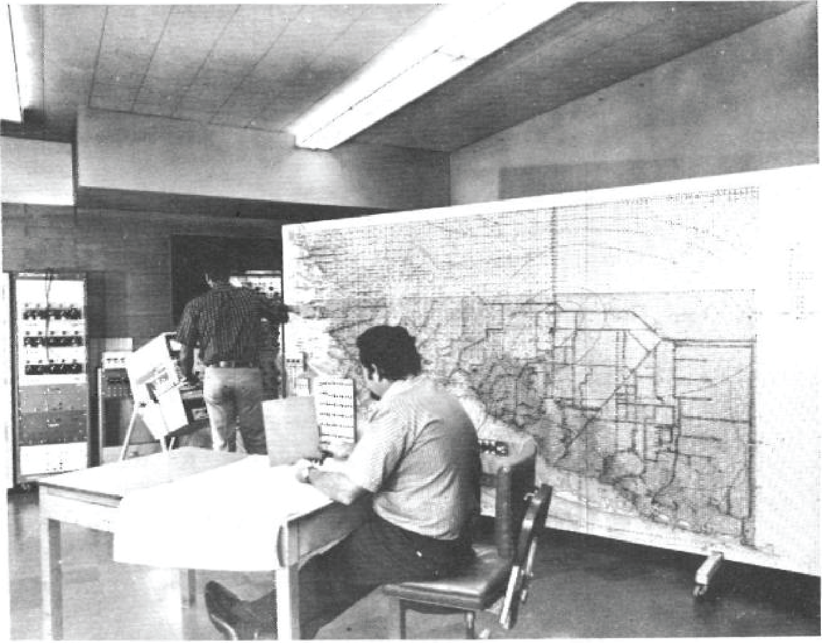
Groundwater Modeling (before computers)
Electric analog groundwater model of Miami, Florida.
Notes:
Prior to computers and numerical software, groundwater models were developed using electric analog models. Large wooden panels with many resistors were constructed to simulate the flow of water. Ohm’s Law was used as the electric analog for Darcy’s Law. This is an example of an electric analog model of the Miami area in Florida.

Slide 3
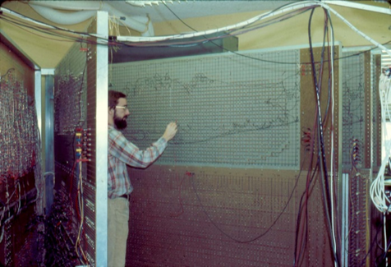
Groundwater Modeling (before computers)
Arlen Harbaugh (retired USGS) works on the Long Island, New York, electric analog model. Each panel represents a different hydrogeologic unit.
Notes:
This is another example of an electric analog model. This electric analog model is for Long Island, New York. The person in the photograph is Arlen Harbaugh, one of the original creators of the MODFLOW program. There are multiple wooden panels for this model, and each panel represents a different model layer.

Slide 4
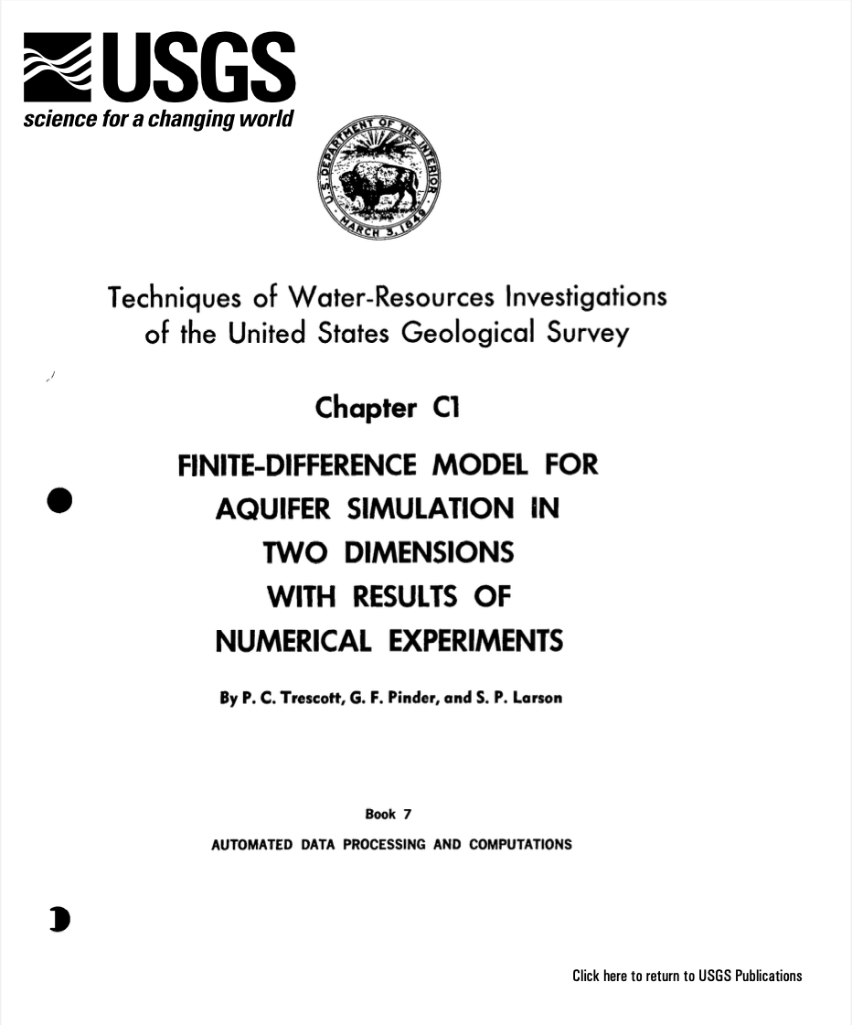
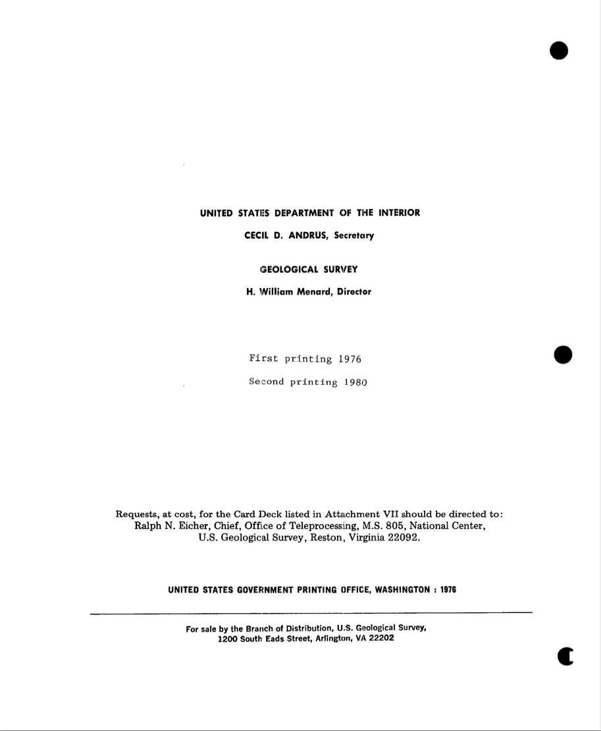
Groundwater Modeling (before MODFLOW)
Notes:
The Trescott/Pinder/Larson software was a precursor to MODFLOW. It was used for different studies by the U.S. Geological Survey. The software was often modified for each groundwater investigation by project scientists. This resulted in many different versions of the program, which made it difficult to meet USGS documentation requirements and to maintain the quality of the software.

Slide 5
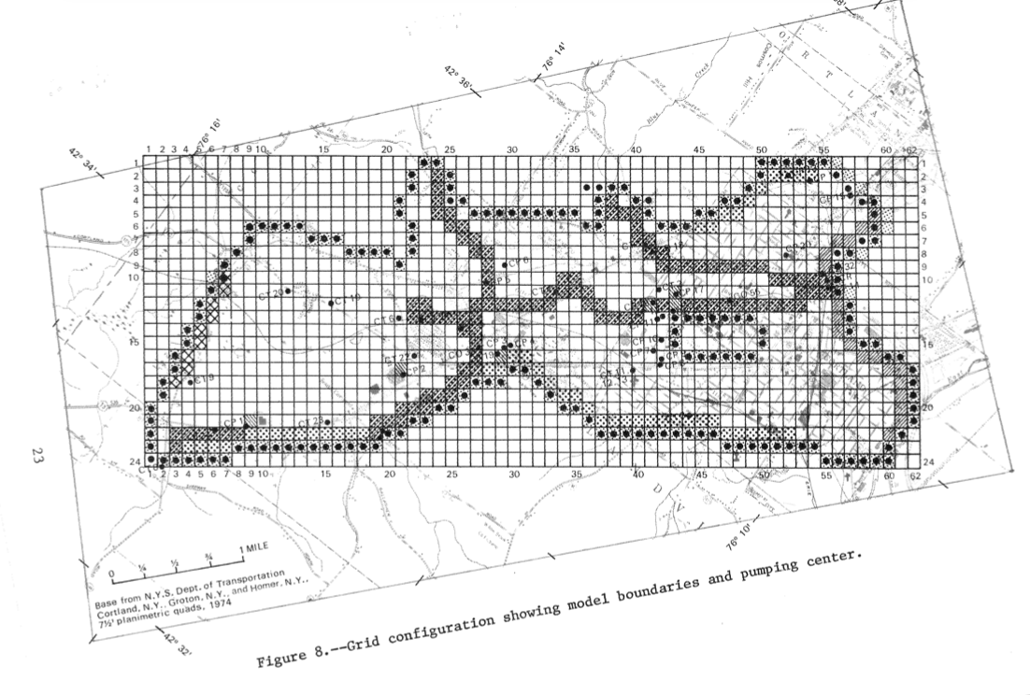
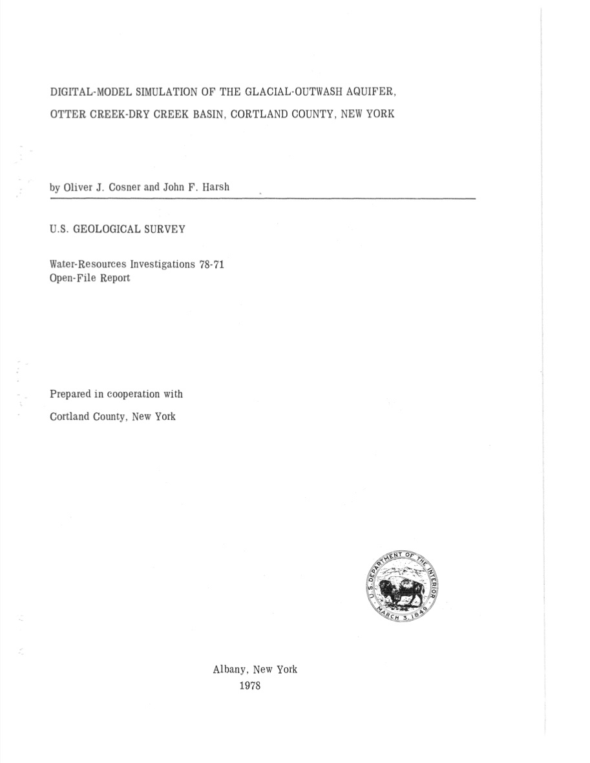
Groundwater Model Example, 1978
Notes:
This is an example of a USGS groundwater model of a glacial aquifer in New York State. The model was published in 1978, and used a version of the Trescott/Pinder/Larson modeling software.

Slide 6
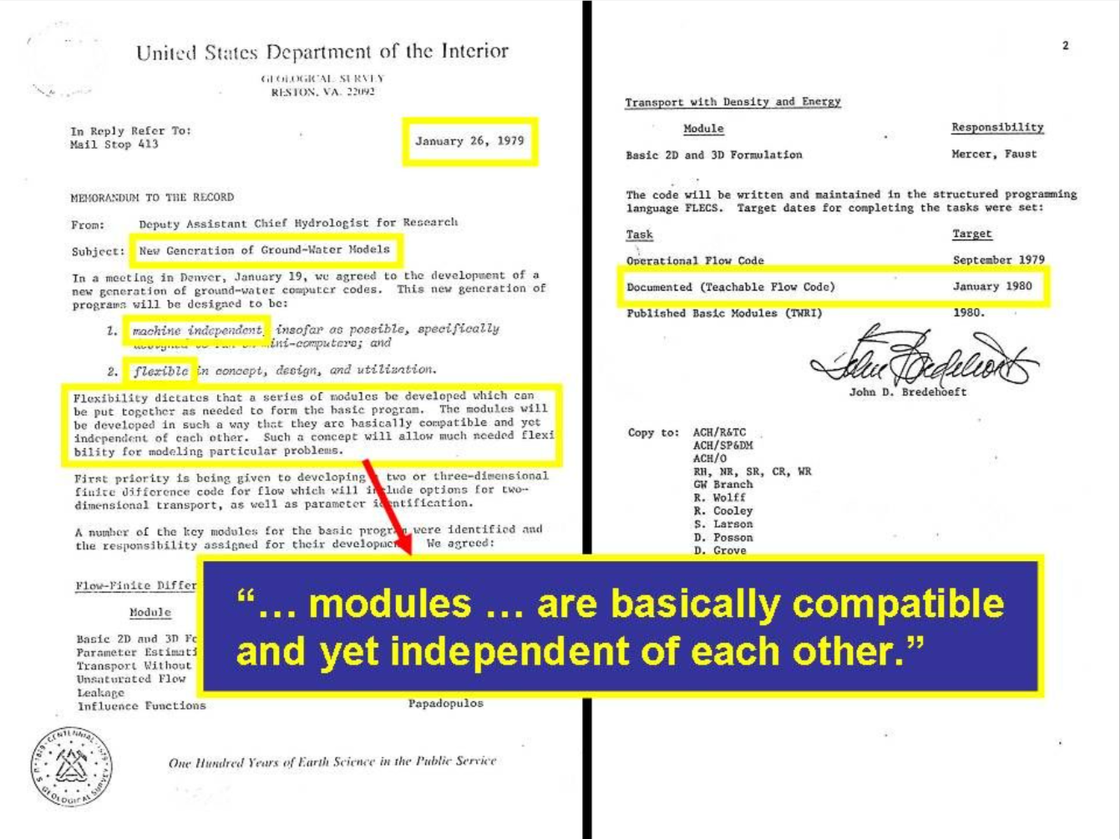
Notes:
In the late 1970s, the USGS decided it was time to consolidate the best features of the many different groundwater modeling programs that had been developed. The goal was to create a modular program that could be extended as new features were needed. This memorandum is the authorization for the development of MODFLOW.

Slide 7
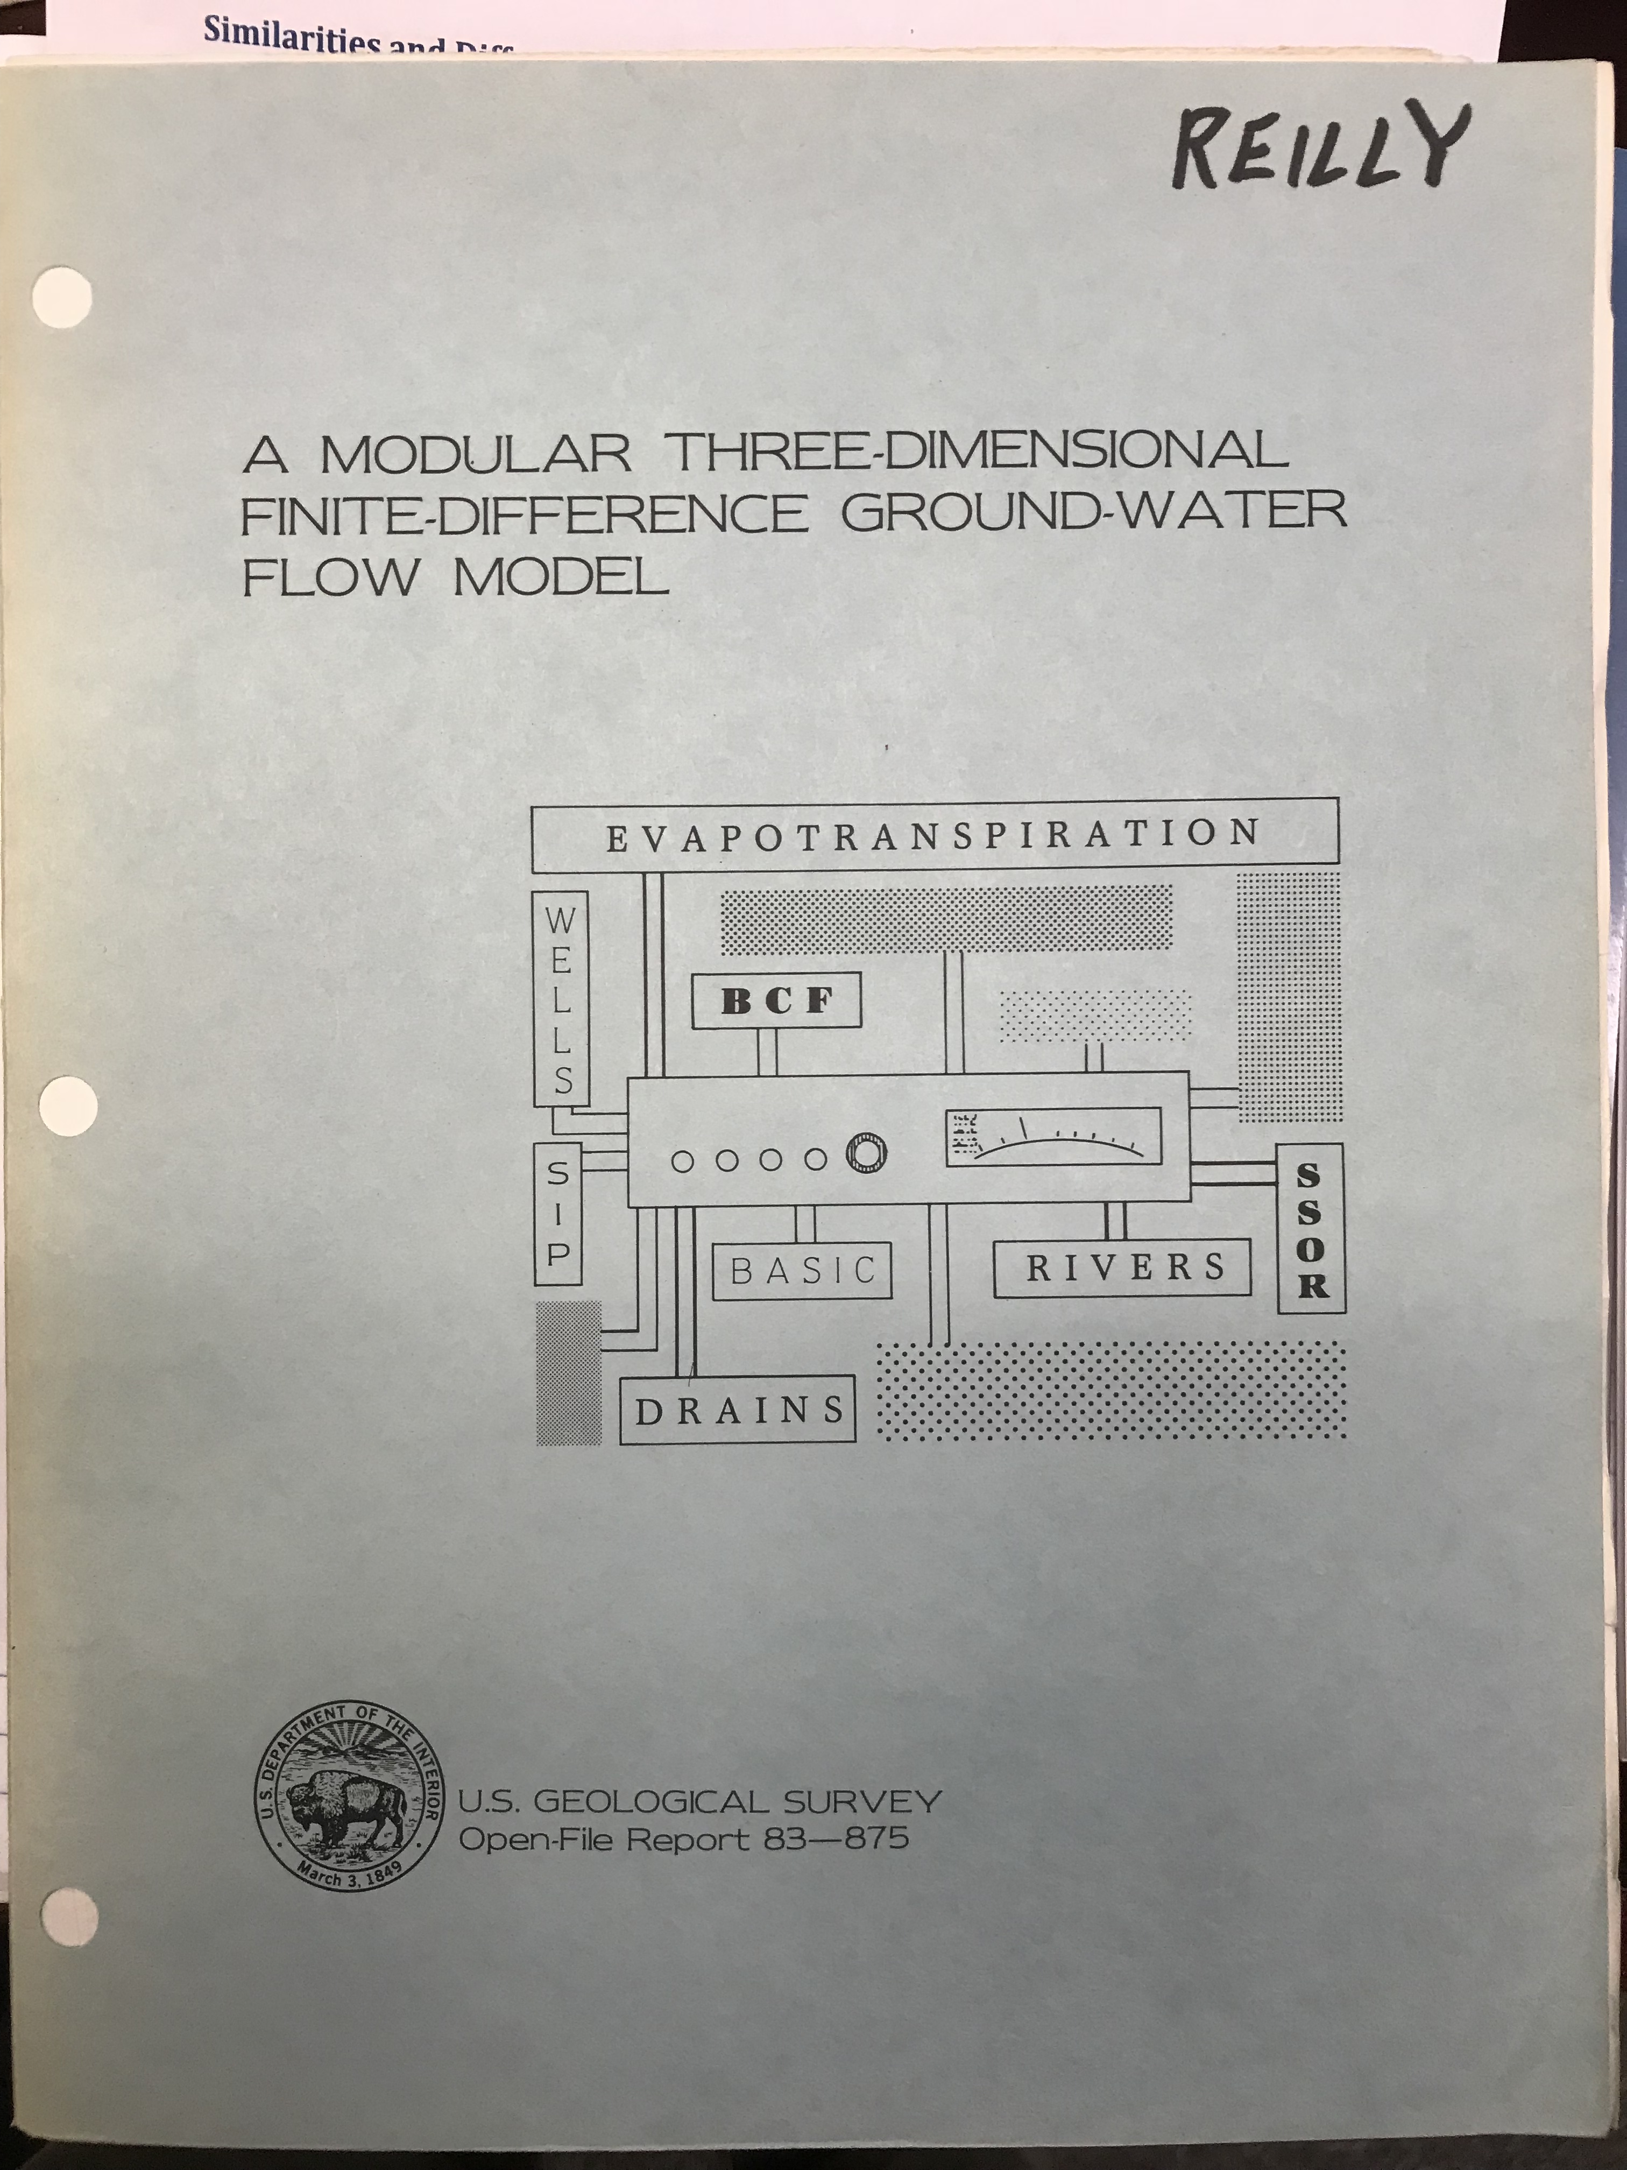
“MODFLOW” 1984
Notes:
The is the cover of the first release of “MODFLOW”. It was published in 1984.

Slide 8
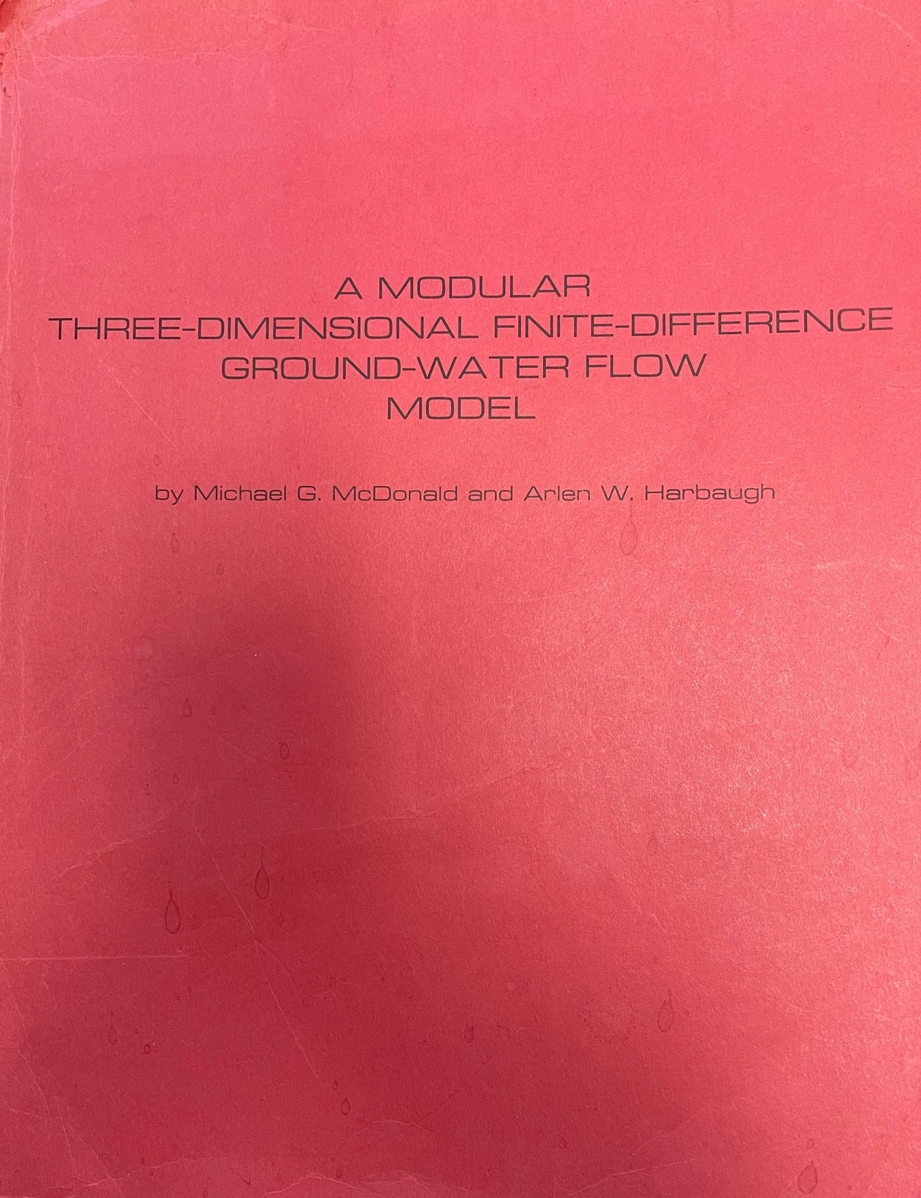
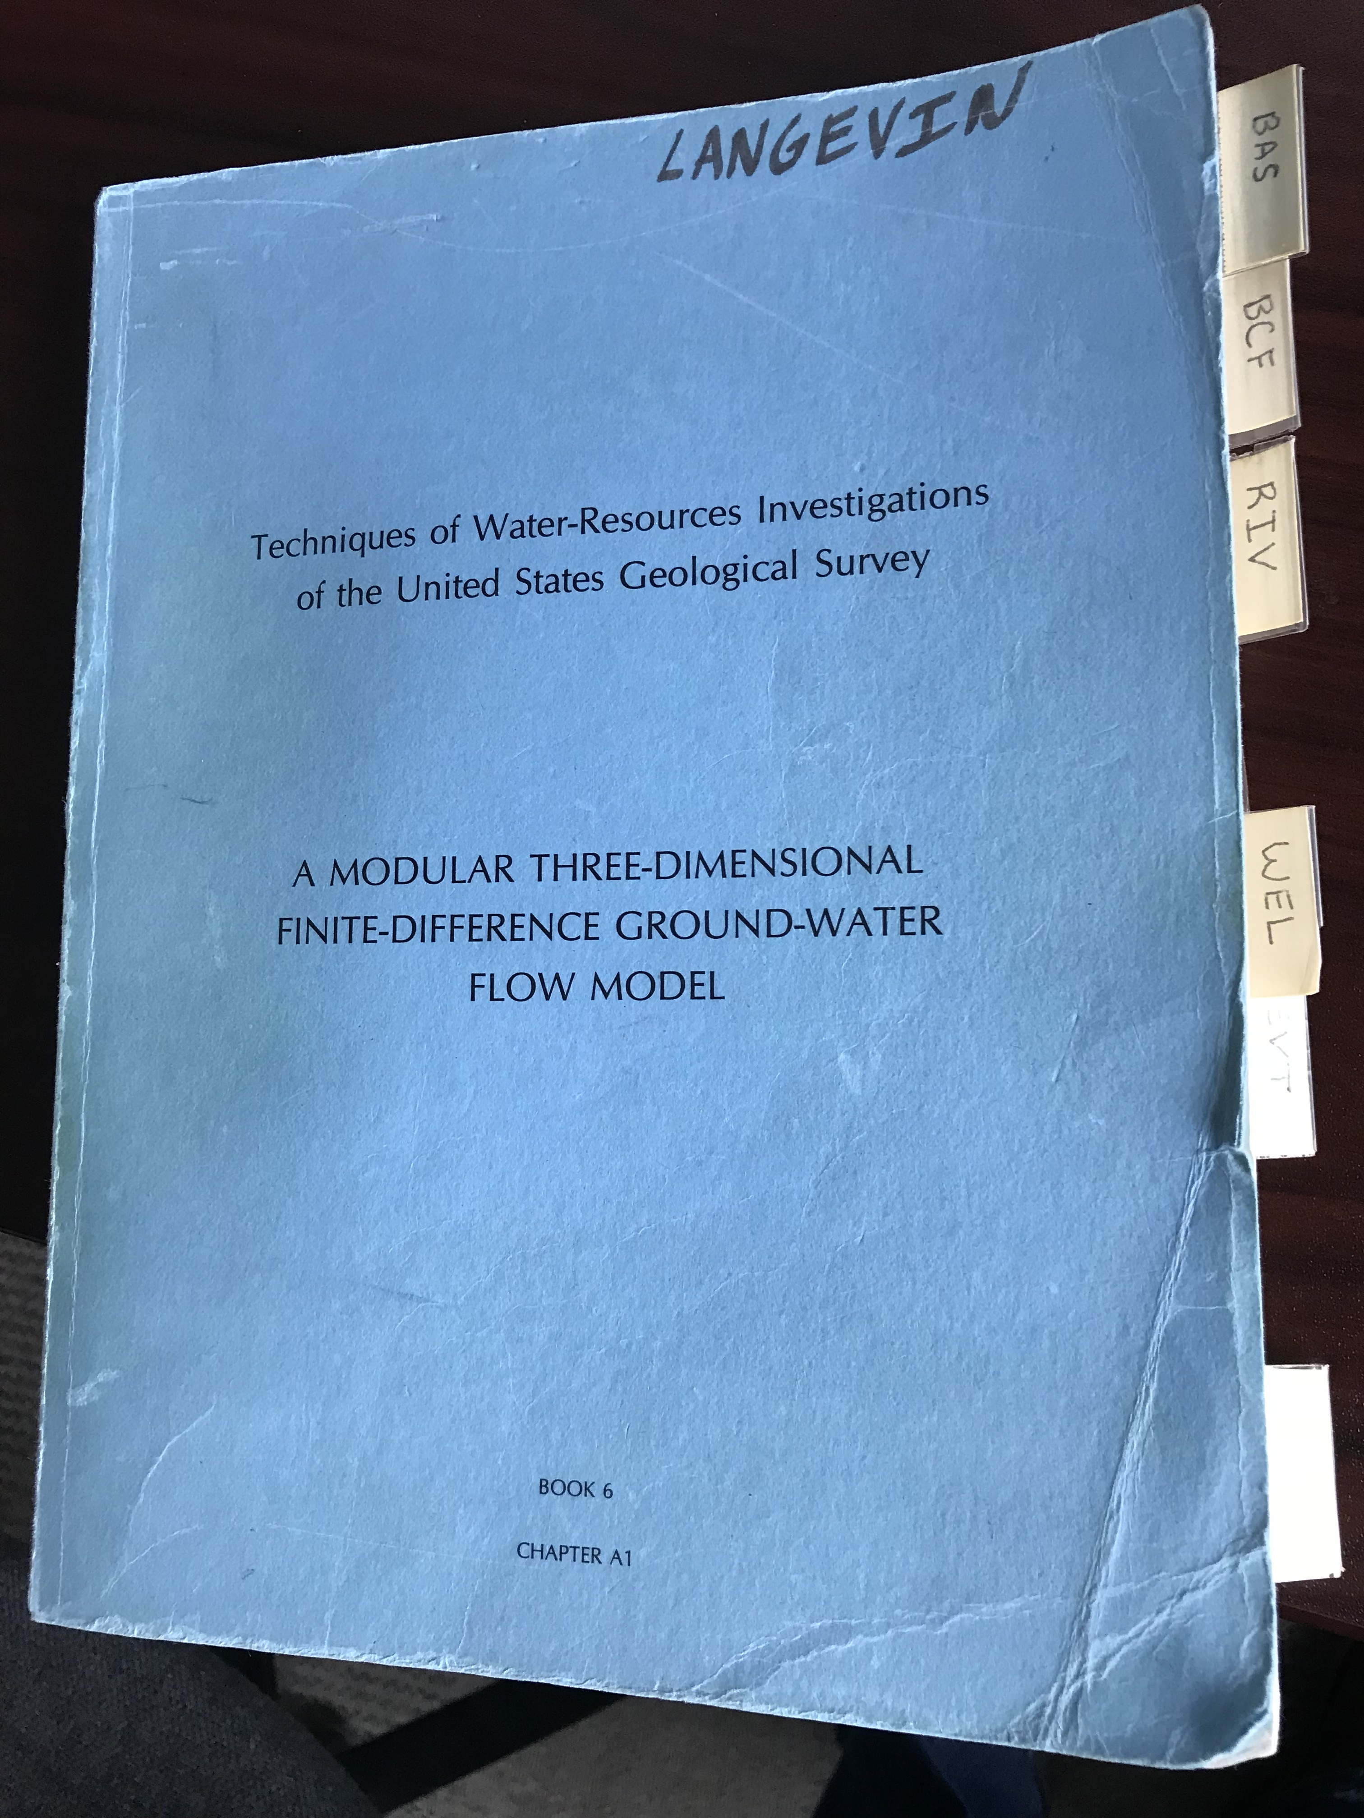
“MODFLOW” 1988
Notes:
The MODFLOW manuals were distributed widely and quickly became popular. The image on the right is a copy of the manual that I obtained in graduate school. MODFLOW users would often mark the individual sections for quick reference.

Slide 9
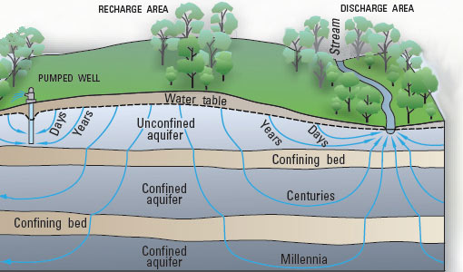
What is MODFLOW?
MODFLOW is a groundwater flow simulator
The program simulates three-dimensional groundwater flow under steady-state or transient conditions
Notes:
MODFLOW has traditionally been a groundwater flow simulator. It simulates three-dimensional groundwater flow under steady-state or transient conditions.

Slide 10
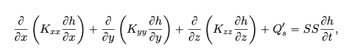
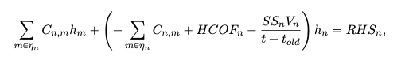
Underlying Equations
MODFLOW solves the groundwater flow equation:
Discretized Control-Volume Finite-Difference (CVFD) approximation:
Notes:
MODFLOW solves the three-dimensional groundwater flow equation using a control-volume finite-difference (or CVFD) approximation using numerical solution techniques.

Slide 11
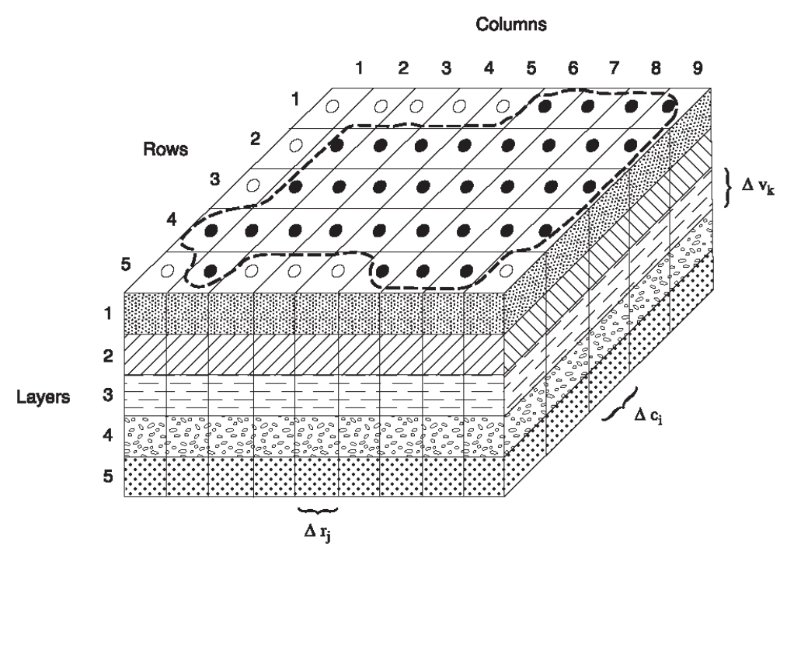
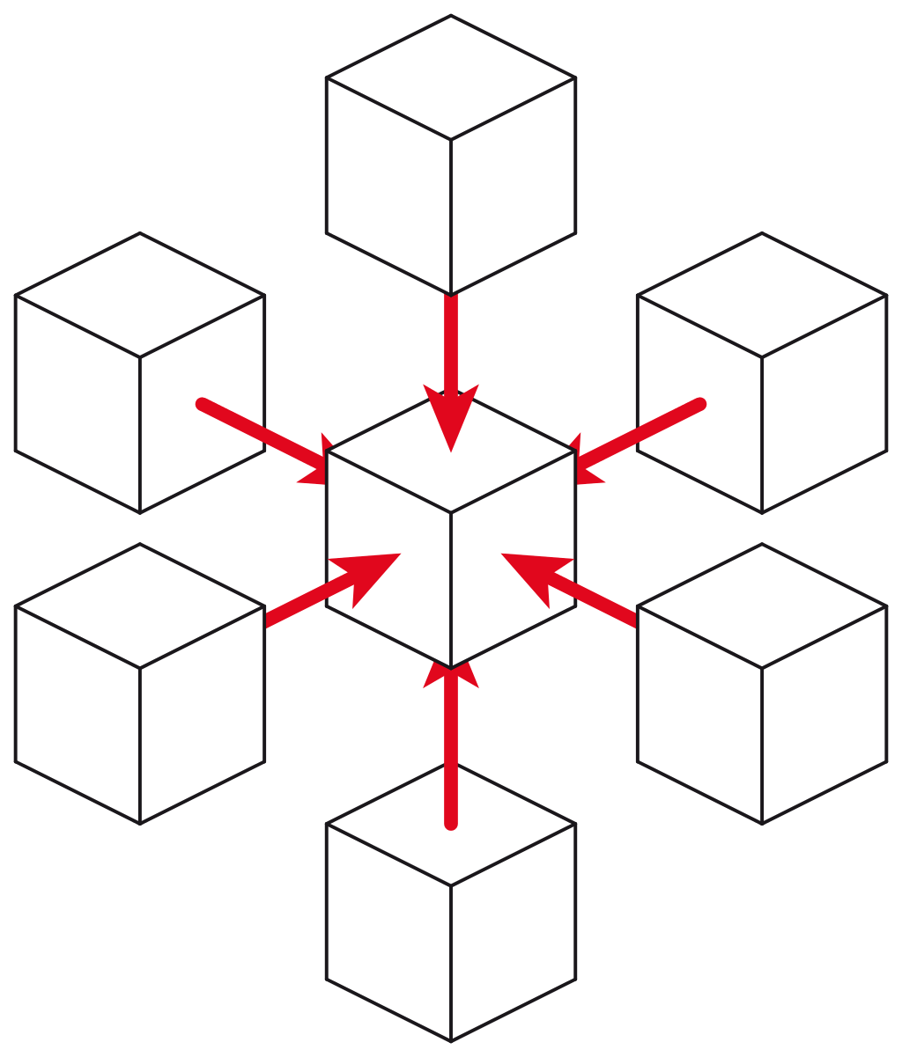
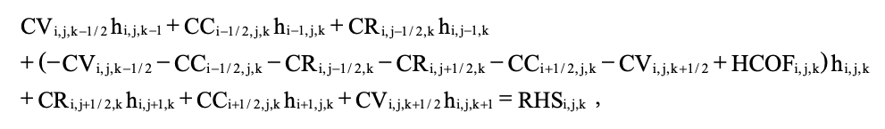
Structured Versus Unstructured Finite-Difference Equation
Structured 7-point stencil
Unstructured
Notes:
MODFLOW has traditionally used a 7-point finite difference equation for groundwater flow. In 2013, the USGS released MODFLOW-USG, which is an unstructured grid version of MODFLOW. MODFLOW-USG and MODFLOW 6 use unstructured forms of the CVFD equation to provide more flexibility for spatial discretization. With the unstructured CVFD equation, a cell can be connected to any number of surrounding cells.

Slide 12
MODFLOW “Packages”
A part of the MODFLOW program that handles a specific simulation aspect
Examples include:
Well
Drain
River
General-Head Boundary
Recharge
Evapotranspiration
Users can turn packages on or off depending on simulation needs
Notes:
One of the reasons MODFLOW has become so popular is that the program is divided into “packages”. These packages typically have names that are familiar to groundwater scientists, like the Well Package, the Recharge Package, and the Evapotranspiration Package. Users can turn packages on and off, depending on simulation needs. Users only need to learn about and understand the packages that are relevant to a study.

Slide 13
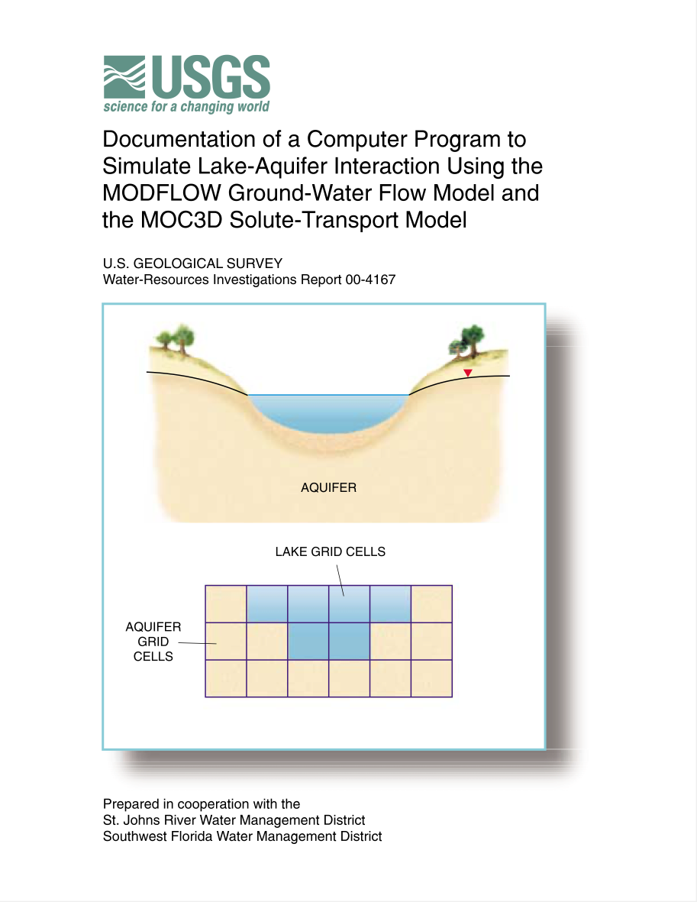
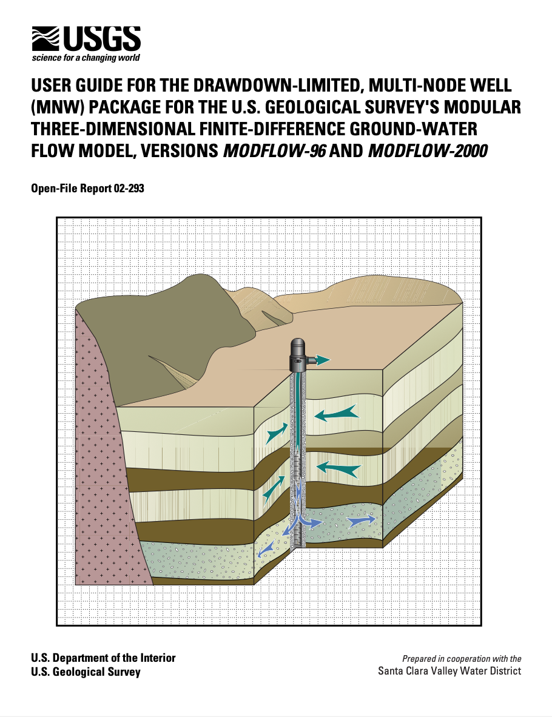
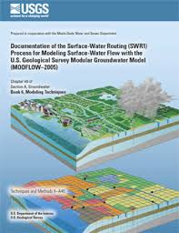
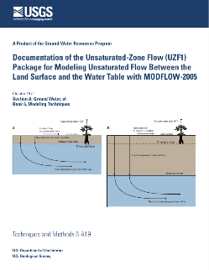
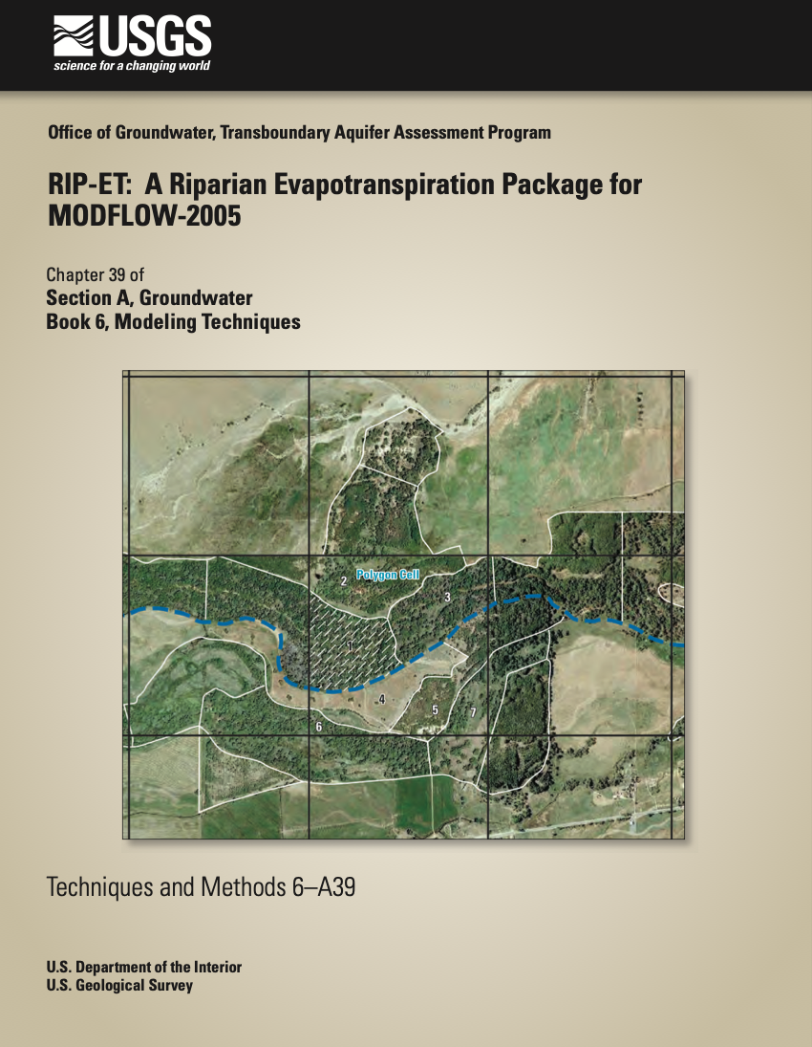
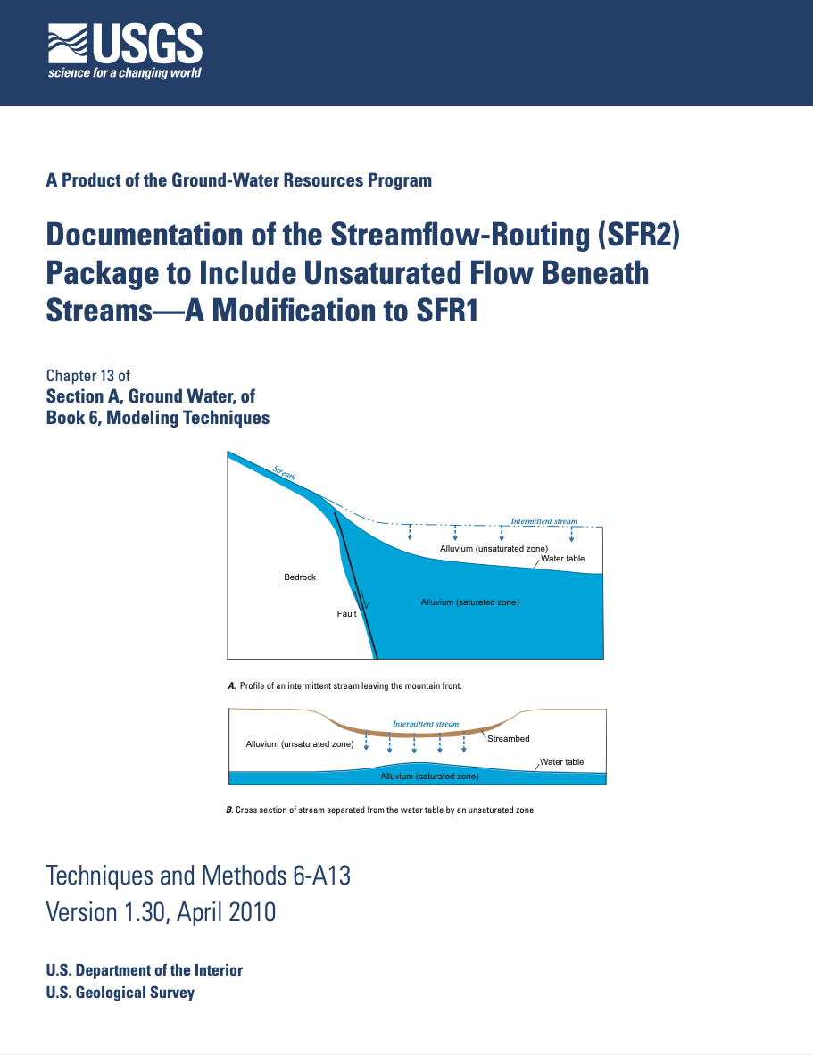
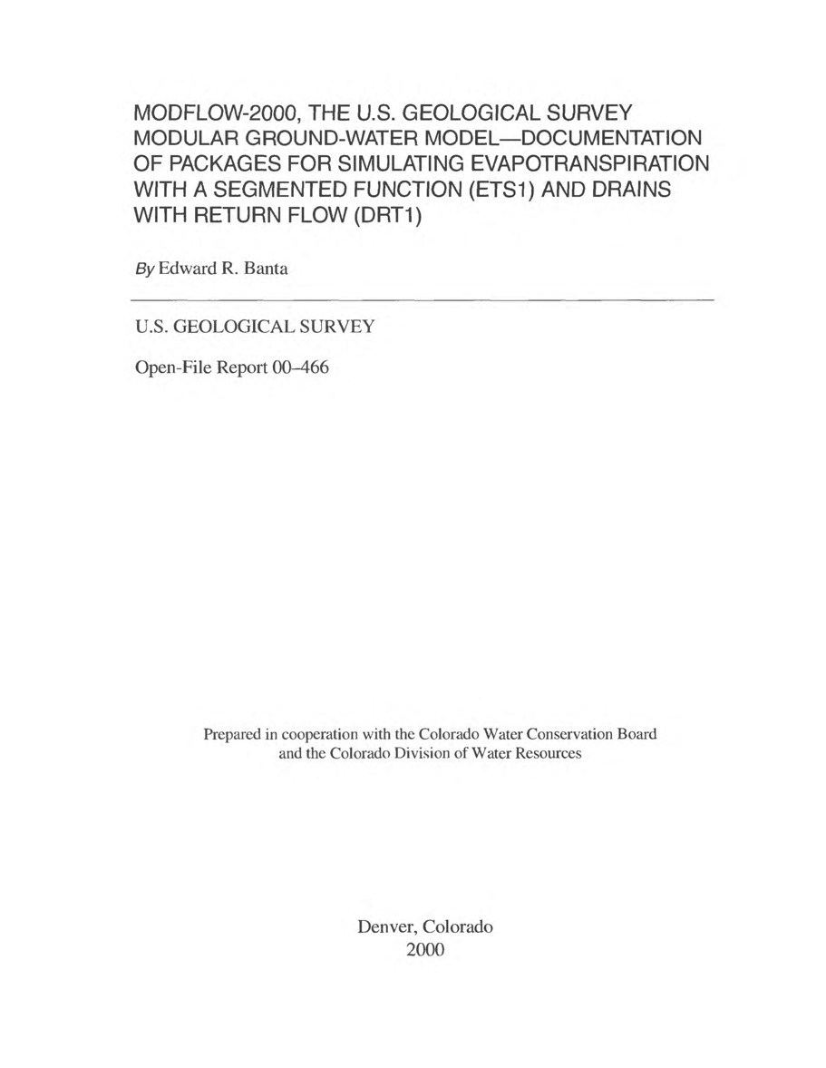
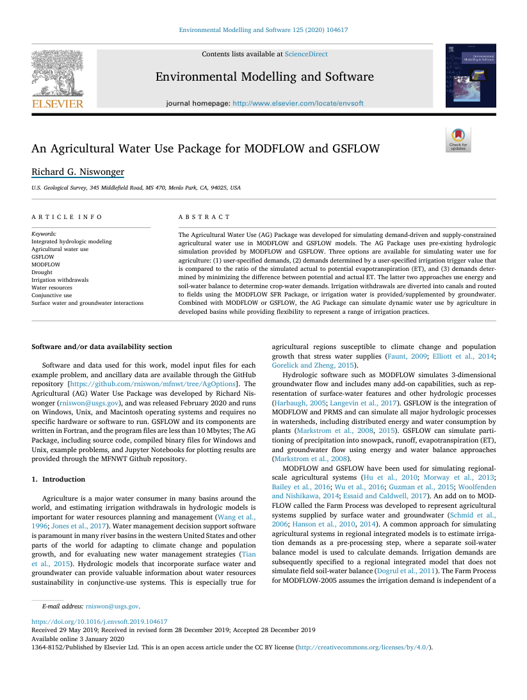
Many Different MODFLOW Packages…
Packages have become more complex over time, and in many cases, they model a physical process
Notes:
Packages were designed to be independent and act solely as a stress on an aquifer. Over time, packages became much more complex, often times representing a full hydrologic process, such as stream flow or unsaturated flow. It also became necessary for packages to communicate with other packages, so that streams could flow into lakes, for example.

Slide 14
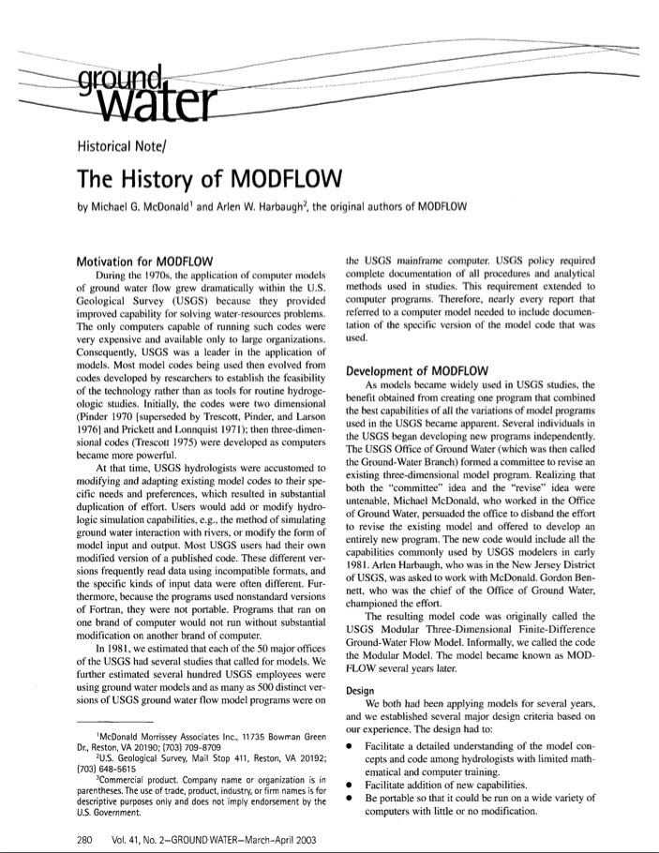
History
MODFLOW introduced almost 40 years ago
Referred to a ”community model”
Designed to be modular, teachable, portable, and extensible
Has had stable funding
Notes:
There is a nice paper in the Groundwater journal on the history of MODFLOW. The program is almost 40 years old now. It is referred to as a community model, that is modular, teachable, portable, and extensible. Fortunately, it has had stable funding by the USGS for continued development and improvement.

Slide 15
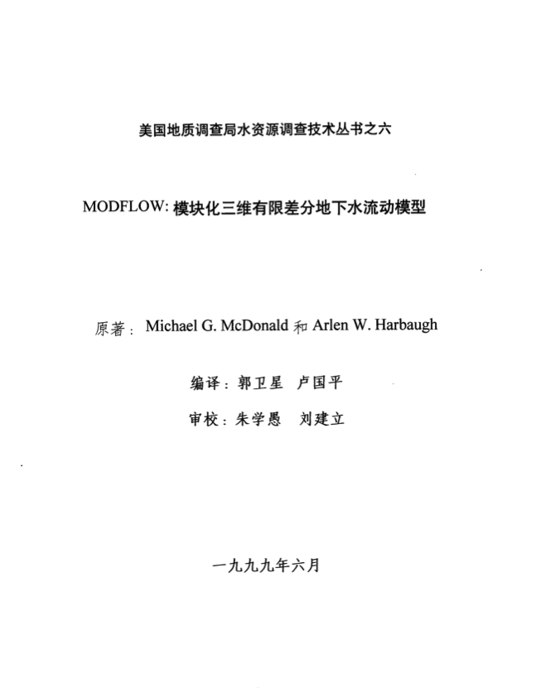
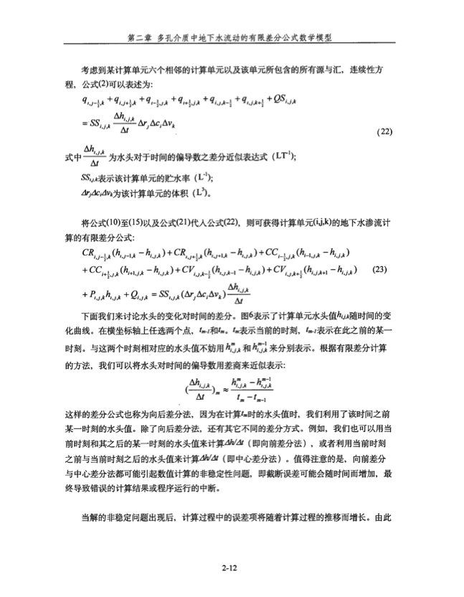
MODFLOW-88 Published in Chinese
Notes:
The program has become quite popular, and the 1988 user manual has been published in Chinese.

Slide 16
Quotes on MODFLOW Popularity
“A Geraghty and Miller survey of more than 5,000 groundwater modelers conducted in 1993 indicated MODFLOW was the most widely used groundwater model in the world. More than 23,000 copies of MODFLOW were downloaded from the main USGS web site from 1990 to 2000. Its popularity has continued, in part due to the modularity of the program and the resulting ability of USGS and others to add capabilities.”
Source: http://igwmc.mines.edu/software/igwmcsoft/MODFLOWreview.htm
“Part of MODFLOW’s popularity stems from its time-tested reputation in court proceedings, where it has withstood the scrutiny of many expert scientists.”
Source: Harter, T. and Morel-Seytoux, H. 2013. Peer Review of the IWFM, MODFLOW and HGS Model Codes: Potential for Water Management Applications in California’s Central Valley and Other Irrigated Groundwater Basins. Final Report.

Slide 17
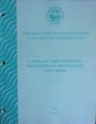
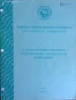
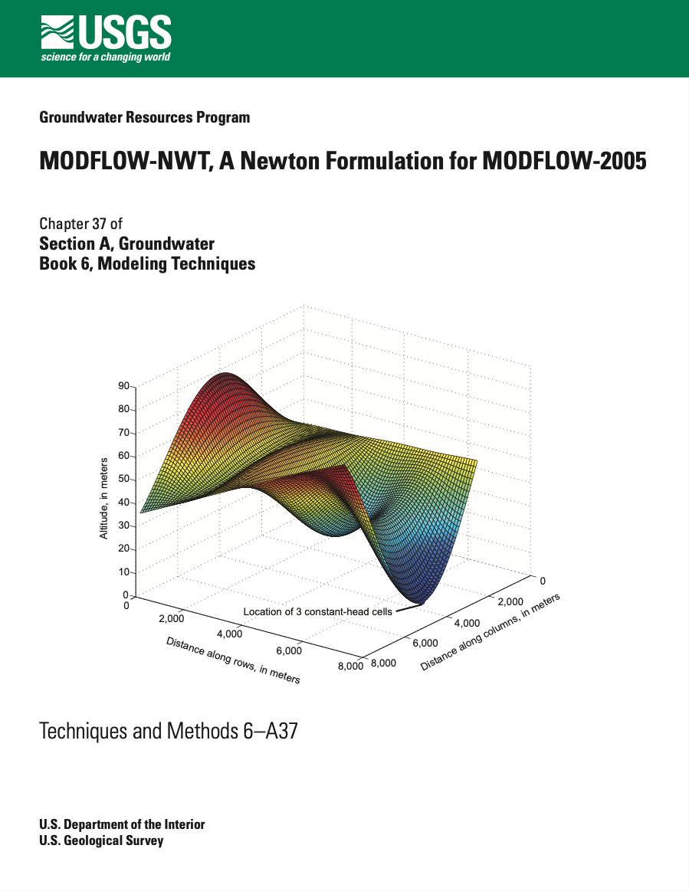
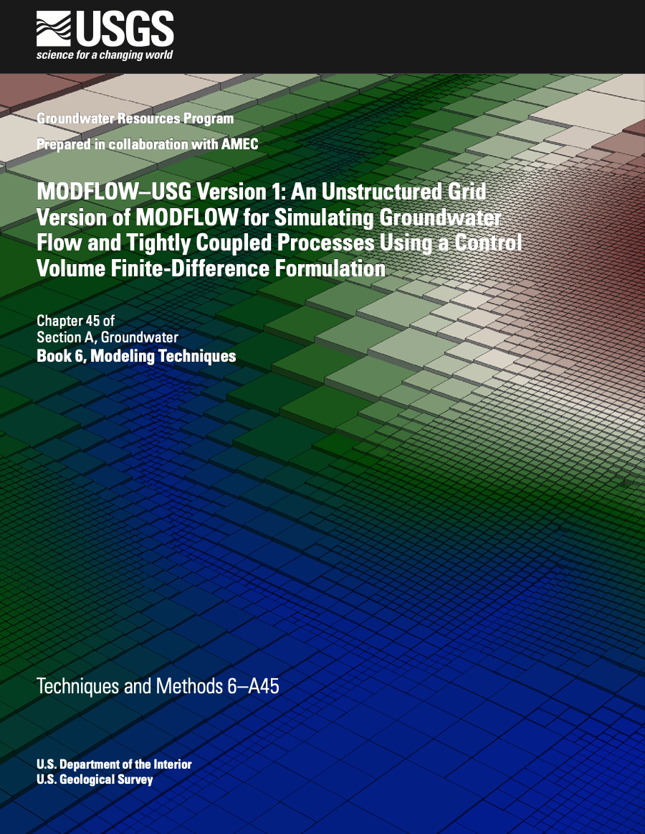
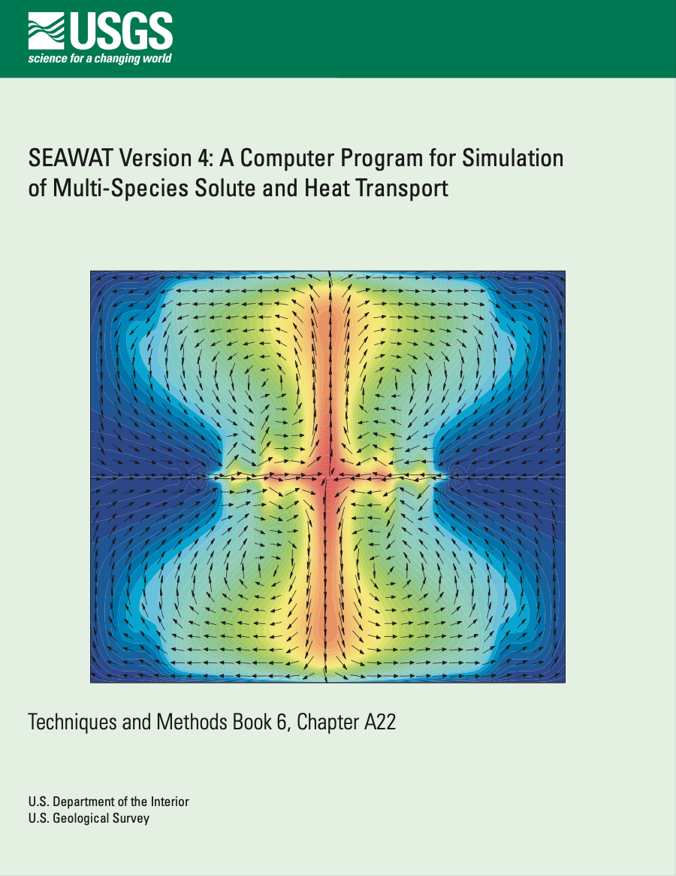
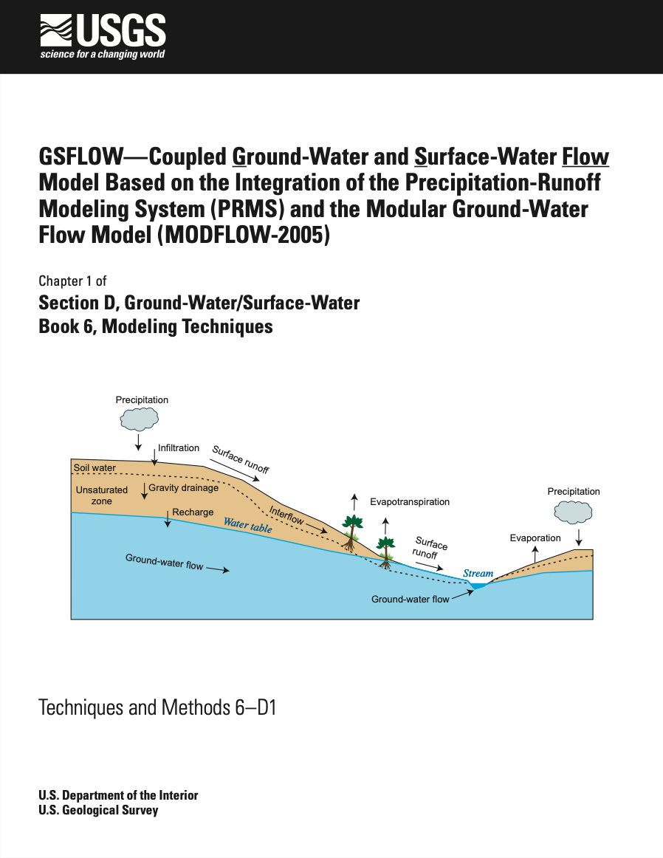

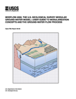
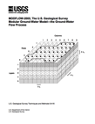
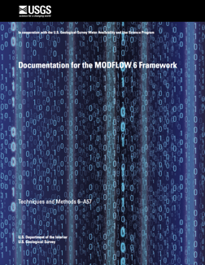
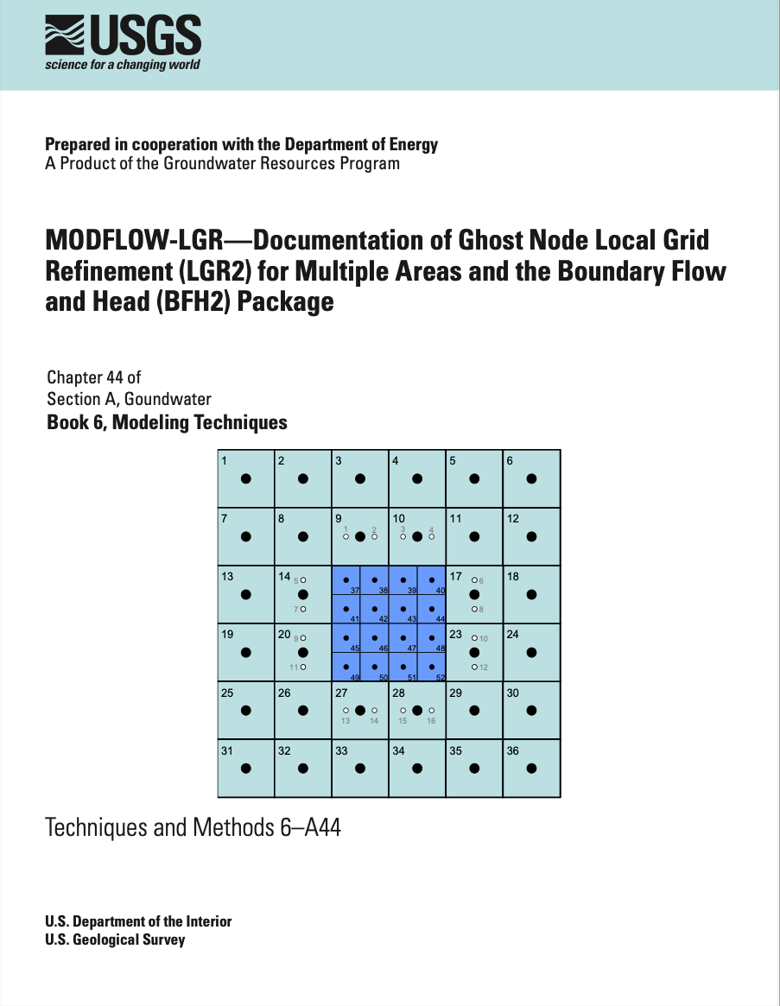
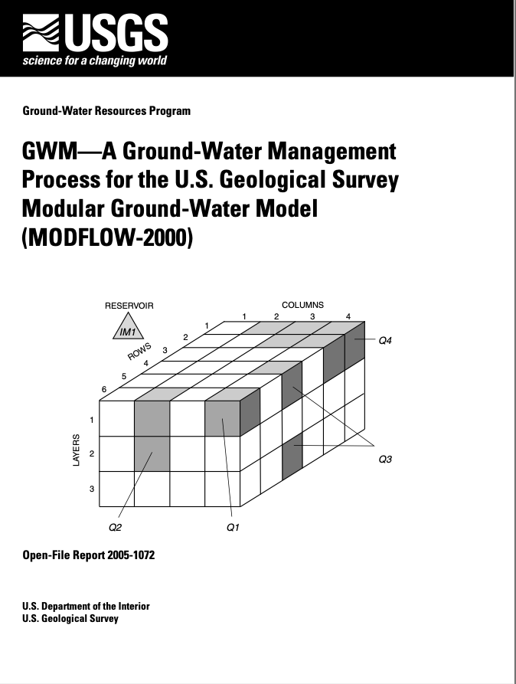
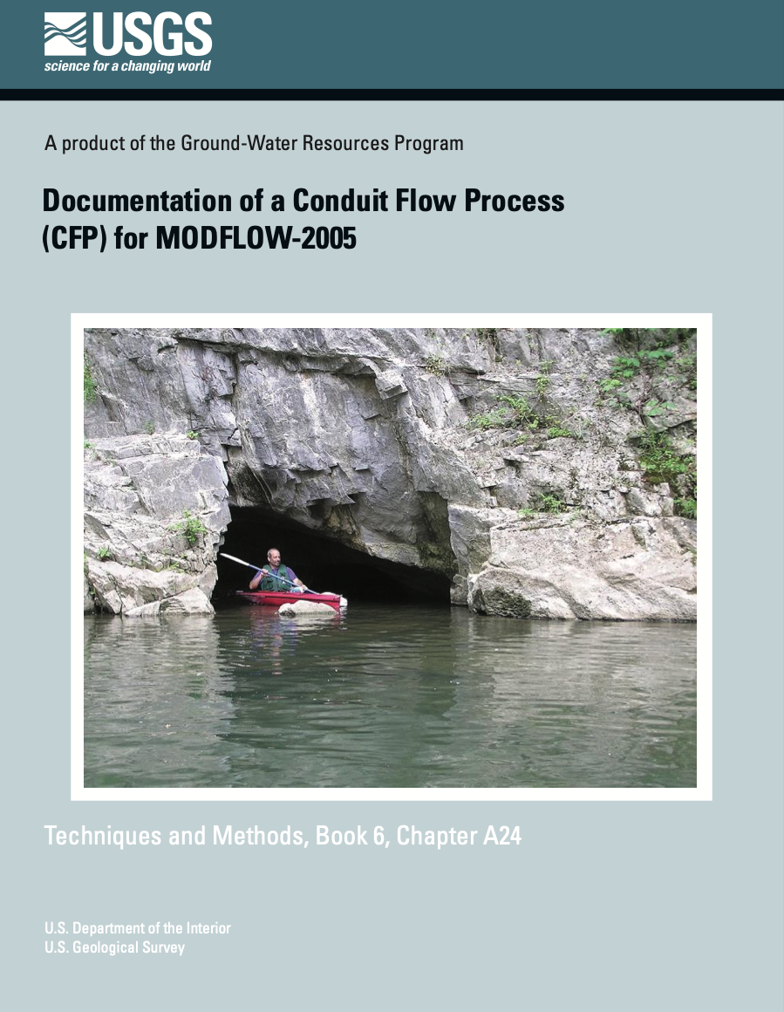
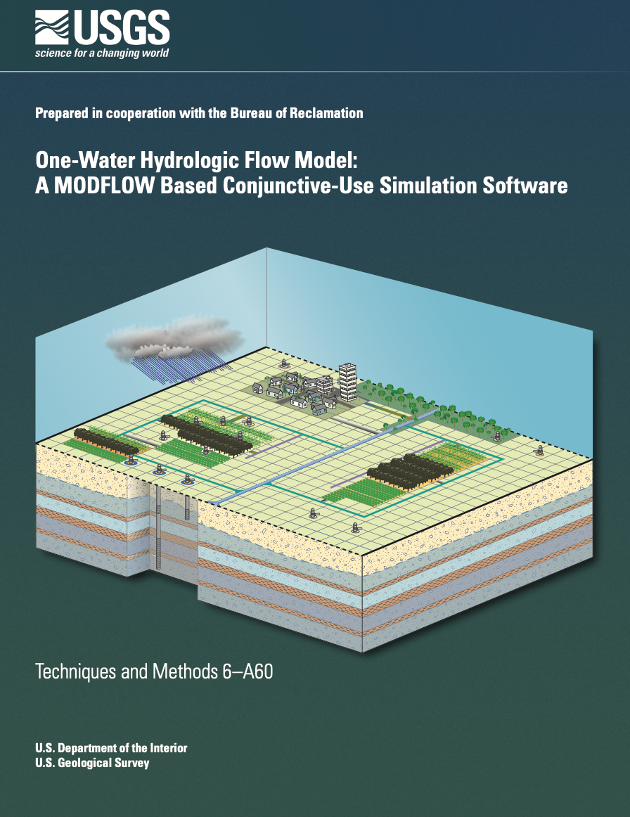
MODFLOW Versions and Variants
Core Version
Development Paths
Variants
NWT
USG
SEAWAT
GSFLOW
1984
1988
1996
2000
LGR
GWM
CFP
OWHM
2005
2017
Notes:
From the USGS perspective, we have tried to maintain a “core” version of MODFLOW that could be relied upon for production. From this core version, we support MODFLOW offshoots to implement and extend MODFLOW for new purposes. Once these variants are shown to be generally useful, these capabilities are brought into the core version, often time requiring major updates to the program.

Slide 18

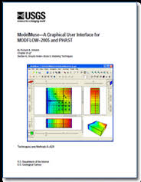
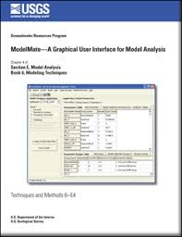
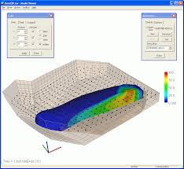
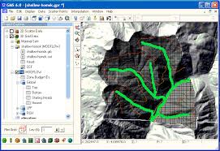
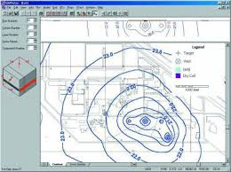
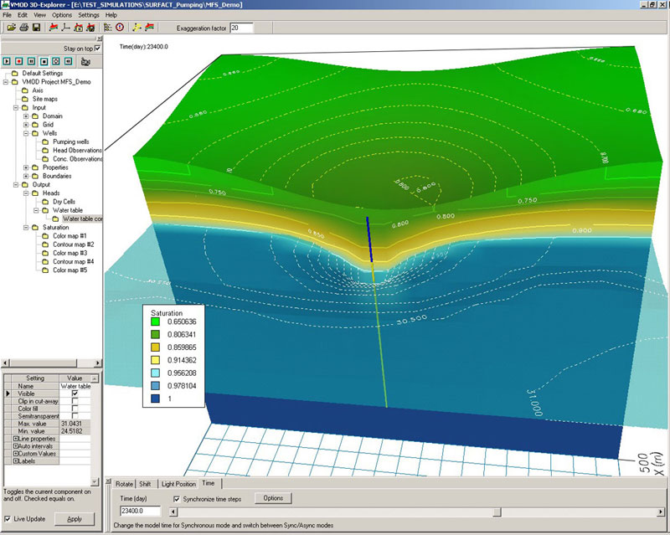
Graphical User Interfaces
USGS
ModelViewer
ModelMuse/ModelMate/GW_Chart
Commercial
Groundwater Vistas
GMS
Visual MODFLOW
PMWIN
Open Source
FloPy, mflab

Slide 19
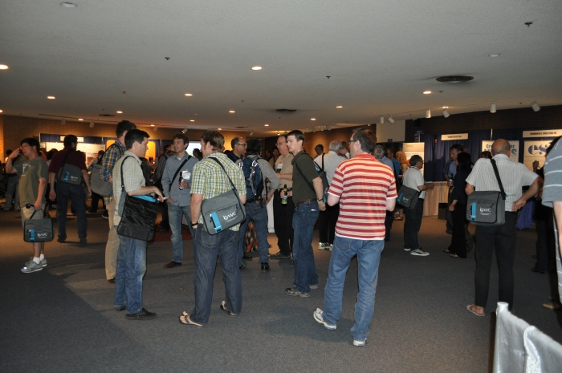
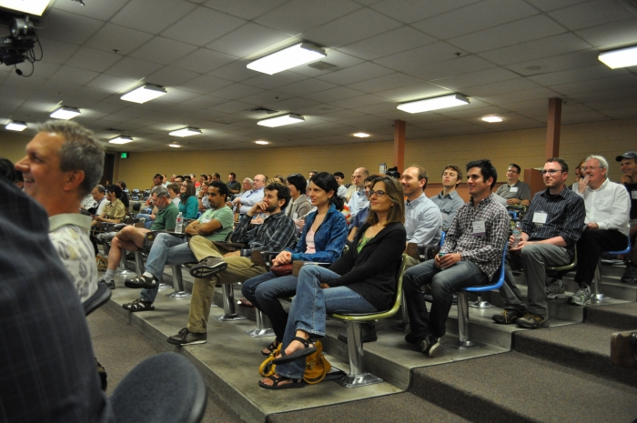
The MODFLOW and More Conference
Frequency:
Every 2-3 years at the Colorado School of Mines; now held at Princeton University
History
1998, 2001, 2003, 2006, 2008, 2011, 2013, 2015, 2017, 2019, 2022
Purpose
“bring together the users and developers of MODFLOW and related modeling programs to present the latest innovations in model applications, discuss the capabilities and limitations of MODFLOW, and explore the needs and directions for future developments.”

Slide 20
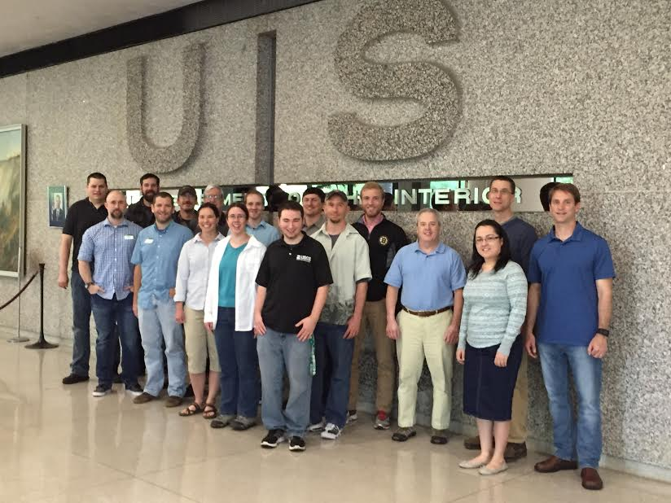
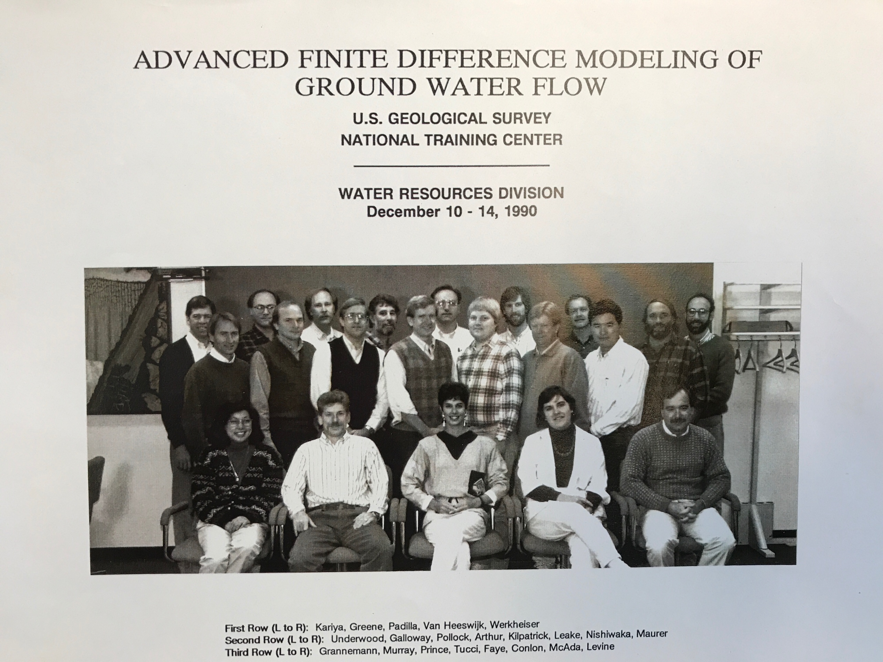




Training

Slide 21
MODFLOW 6
MT3DMS
MT3D-USGS, USG
SEAWAT, SWI, GWT
GSFLOW-PRMS
SWB, HSPF, SWAT
OWHM
Solute and Heat
Transport
PHREEQC-PHT3D
PHWAT
RT3D
Landscape
Hydrology
Reactive
Transport
MODPATH
mod-PATH3DU
PATH3D
FlowSource
SAMG
PKS-MODFLOW
PKS-SEAWAT
MODFLOW 6
Parallel
Flow Path
Analysis
Groundwater Vistas GMS Visual MODFLOW PMWIN ModelMuse Groundwater Desktop Leapfrog Hydro FREEWAT iMOD ModelViewer FloPy Graphical Interfaces and Scripting
Core Principles
Teachable
Documented
Reliable
Robust
Efficient
Extensible
Portable
Subsidence
Karst and
Pipe Flow
SUB
CSUB
MODFLOW-USG
CFP, VKD
Unstructured
Grids
Management
PESTPP-OPT
MODSIM
GWM
MODFLOW-USG
MODFLOW 6
Parameter
Estimation
and Uncertainty
Unsaturated
Zone
Surface Water
Flow
PEST
PESTPP
UCODE
UZF
HYDRUS
VSF
SFR, SWR
HEC-RAS
BRANCH
MODFLOW
ECOSYSTEM OF CODES

Slide 22






Range of Scales for MODFLOW Applications
bench
site
subregional
regional
national
global
Notes:
One of the interesting things about MODFLOW is that is has been used for a very wide range of scales. We can use MODFLOW to simulate flow in a Darcy flow tube all the way up to the continental and even global scales.

